Slide 1
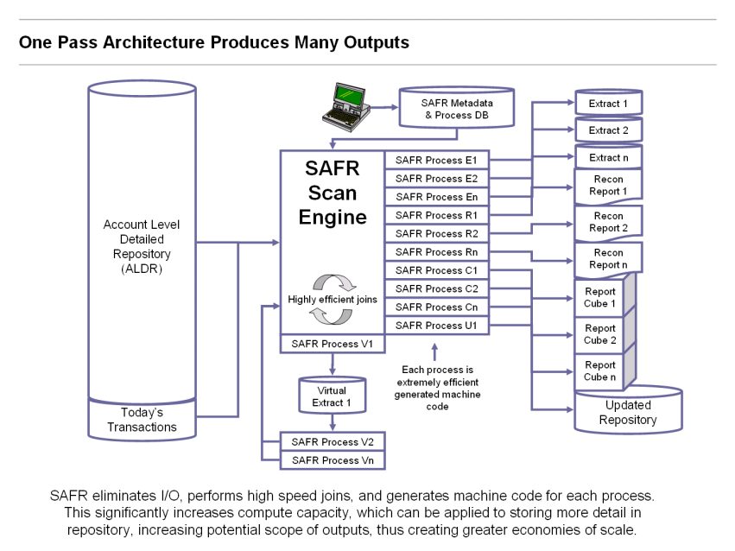
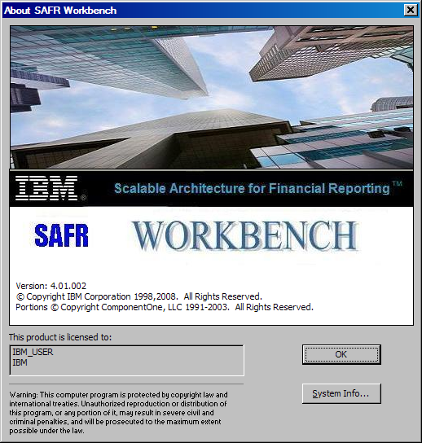
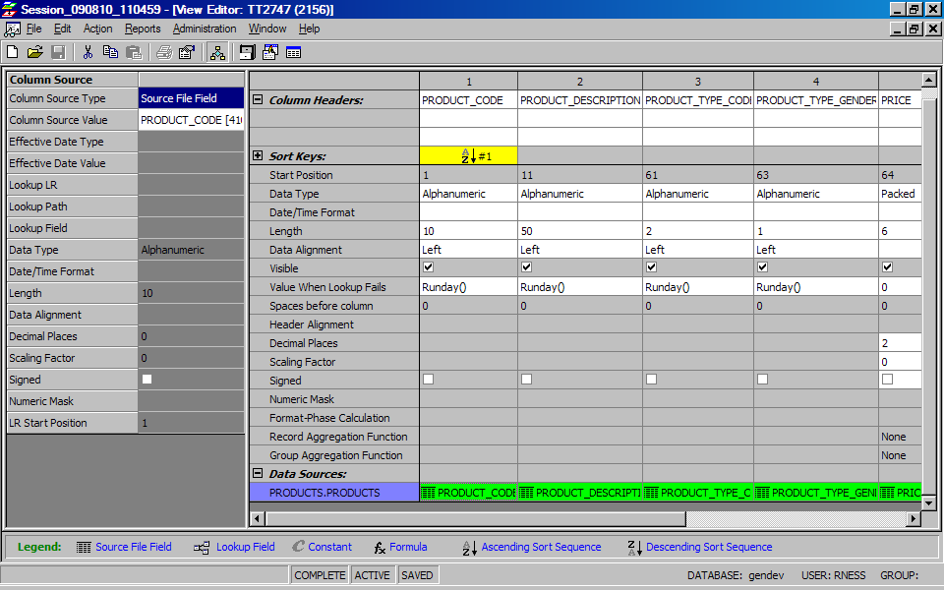
Outline
What is GenevaERS
Services asset composed of 100k lines of z/OS assembler code, C++, and Eclipse
Generates highly efficient machine code for tremendous scalability
Can be used to simply ETL processes all the way to a platform for developing a complex financial and reporting application
Created for reporting processes for world’s the largest financial organization
Has had 20 customers over its 30 years history; currently used by two major FIs as heart of financial, statistical, and KPI processes
What it is Not
A database or database centric technology
An end-user query tool
What it Does
Closes the financial books of record on a daily basis – no other application in the marketplace can do this
What are the Business Benefits
Allows data analysis at very low levels of detail
And of many more attributes – product; geography; channels
With greater history
Supporting many more financial, regulatory, management and even risk related analysis
Which all reconcile and have the same cut off
Allowing for faster analytics and insight into business trends by not having to wait for monthly or quarterly closes
Saves institutions hundreds of millions of dollars in custom development trying to replicate this asset

Slide 2
GenevaERS Multiple Aspects of Performance
Multiple programs reading same transaction data
Multiple programs reading same reference data
Slow performance due to sequential processing of large data volumes
Sales
Trans
This Year
Sales
This Year
Payments
Sales
Trans
GL Acct
Master
Payment
Trans
Last Year
Sales
GL Acct
Master
Last Year
Payments
History
Sales
History
Payments
Problem
Program
A
Program
B
Program
C
Program
A
Program
B
Program
A
Program
B
Multiple report requests produced simultaneously in a single scan of the transaction data
Load file into memory to avoid redundant reads
Process files in parallel and combine the output
Sales
Trans
Sales
Trans
GL Acct
Master
Payment
Trans
This Year
Sales
This Year
Payments
Last Year
Sales
GL Account
Master
Last Year
Payments
History
Sales
History
Payments
Solution
Geneva Views
A/B/C
Geneva Views
A/B
Internal Reference
Tables
Geneva
Views
A/B
Internal Reference
Tables

Slide 3
A Sample Customer Application
GenevaERS is fundamentally a compiler, for high volume single-pass, scan processes
Specialized Customer
Structure
Traditional Batch Program:
Basic GenevaERS Structure:
1000-Initiate Processing
2000-Read input file until End of File
GenevaERS View 1
GenevaERS View 2
GenevaERS View 3
9000-Terminate Processing
Raw
Data
Transaction Data
I/O Read Exit
Block 1
1 Type 1
Type 2
Type 3
Type 4
1000-Initiate Processing
2000-Read input file until End of File
Perform logic on each record
9000-Terminate Processing
1000-Initiate Processing
2000-Read input file until End of File
GenevaERS View 1
GenevaERS View 2
GenevaERS View 3
9000-Terminate Processing
Block 2
1 Type 1
Type 2
Type 3
Type 4
Raw Data Lookup
Exit
Memory
Table
Output
File
Output
File
Ref
Data
Key Data
1 A
B
C
D
Output
File
Output
File
GenevaERS Pipe Thread

Slide 4
GenevaERS Functionality
High Performance Development Tool
Code converted to machine code at run time
ETL Tool
Transforms inputs from various formats and prepares load-ready outputs
Extracts for Reporting
Summary files, formatting flexibility
In-Memory Processing
Windowed joins of large files
Read-once process-many flow with multiple views and feedback of spawned records into same flow
Streaming Batch Processor
Processes pre-sorted batch sequential files in a continuous stream
DBMS-like Functionality
Views / Lookups / Select / Join / Group-By
Customizable Service
Customer-directed vendor enhancements
Rules Engine
Consumes business rules via XML
Metadata driven layouts, conditions and flows
Geneva ERS
Dev
ETL
DBMS
Rules
Report
In-
Memory
Stream
Custom

Slide 5
Code and Configuration Overview
 | Leveraged Asset Development
Tooling | The SAFR tool is made up of the following code base: Performance Engine (C++) 221,040 Performance Engine (HLASM) 137,802 Work Bench (Java) 308,822 SQL 18,635 Grand Total 686,299 This is a significant asset, nearly 30 years in the making for high performance custom development for the world’s largest organizations
Configuration | One Customer’s GenevaERS Instrument Ledger includes approximately 15 different executions of GenevaERS, each with different configuration parameters One of the more complex Executions includes: 32 different SAFR “views” effectively each an individual program All executed in parallel In a Hierarchy Twelve Levels deep These programs average 72 new transactions across all the required business views for each business event
The SAFR Scan Engine is a parallel processing engine, generating very efficient machine code for IBM z/OS
Each process generates multiple outputs in one pass through the reporting data.
In-memory piping between processes and summarization eliminates additional IO.
Its efficient join algorithms operate on the order of 500,000 joins a CPU second, while its processing capabilities consistently achieve a throughput of a million records a minute.
Although the Scan Engine is a traditional batch process, because it is able to do in minutes what other technologies require hours to accomplish, with more frequent executions it may outperform real-time systems.

